Slide 1
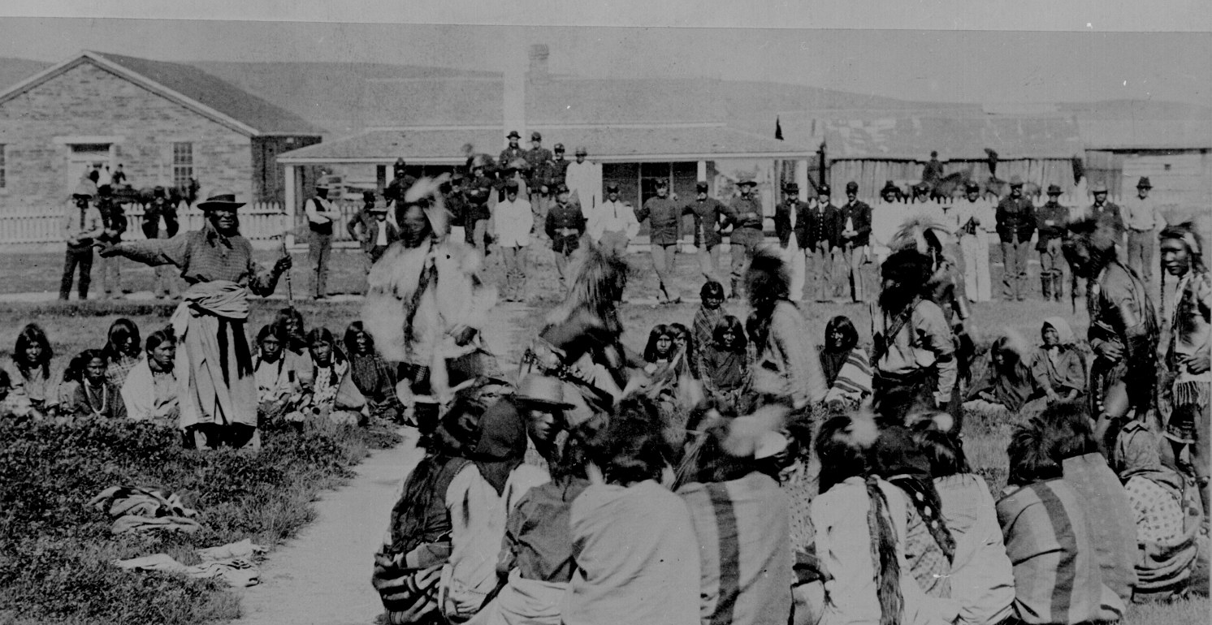
Citizenship for American Indians
CHQ: How will expansion impact Native Americans?

Slide 2
What does it mean to be a citizen?

Slide 3
Notebook Directions
Right side: guiding questions
Left side: respond to central historical question

Slide 4
The Dawes Act, 1887
Authorized the federal government to break up tribal lands
  Lands were partitioned into individual plots
Native Americans were only granted citizenship if they accepted these plots
Objective: assimilate Native Americans
Over 90 million acres of tribal land were stripped from Native Americans and sold to non-natives

Slide 5
Indian Wars 1860-1890
The reservation system was created in 1851 to keep Native Americans off desired lands
  This leads to conflict, resulting in what was known as the Indian wars
    Notable battle: Little Bighorn
      The battle was a major victory for the Sioux but they eventually flee, fearing reprisals from the US Army
      Seen as the beginning of the end of the Indian Wars
        Remaining tribes were forced to cede their lands and move on to reservations

Slide 6
Forty-Ninth Congress of the United States of America; At the Second Session,
Begun and held at the City of Washington on Monday, the sixth day of December, one thousand eight hundred and eight-six.
An Act to provide for the allotment of lands in severalty to Indians on the various reservations, and to extend the protection of the laws of the United States and the Territories over the Indians, and for other purposes.
Be it enacted by the Senate and House of Representatives of the United States of America in Congress assembled, That in all cases where any tribe or band of Indians has been, or shall hereafter be, located upon any reservation created for their use, either by treaty stipulation or by virtue of an act of Congress or executive order setting apart the same for their use, the President of the United States be, and he hereby is, authorized, whenever in his opinion any reservation or any part thereof of such Indians is advantageous for agricultural and grazing purposes, to cause said reservation, or any part thereof, to be surveyed, or resurveyed if necessary, and to allot the lands in said reservation in severalty to any Indian located thereon in quantities as follows:
To each head of a family, one-quarter of a section;
To each single person over eighteen years of age, one-eighth of a section;
To each orphan child under eighteen years of age, one-eighth of a section; and
To each other single person under eighteen years now living, or who may be born prior to the date of the order of the President directing an allotment of the lands embraced in any reservation, one-sixteenth of a section . . .

Slide 7
Video
How is assimilation related to citizenship?
What was the purpose of American Indian boarding schools?

Slide 8
Native Americans will not be granted full citizenship until 1924
  Indian Citizenship Act (Calvin Coolidge)
The land allotment policy will not end until the US Indian Reorganization Act in 1934 (FDR)

Slide 9
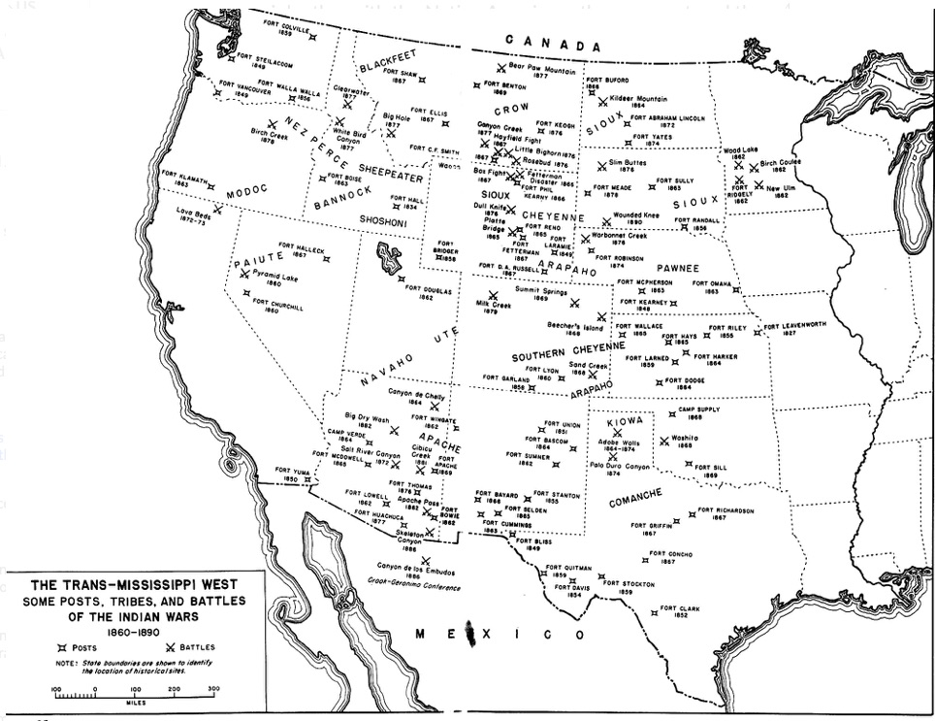

Slide 10
Document A: Move On

Slide 11
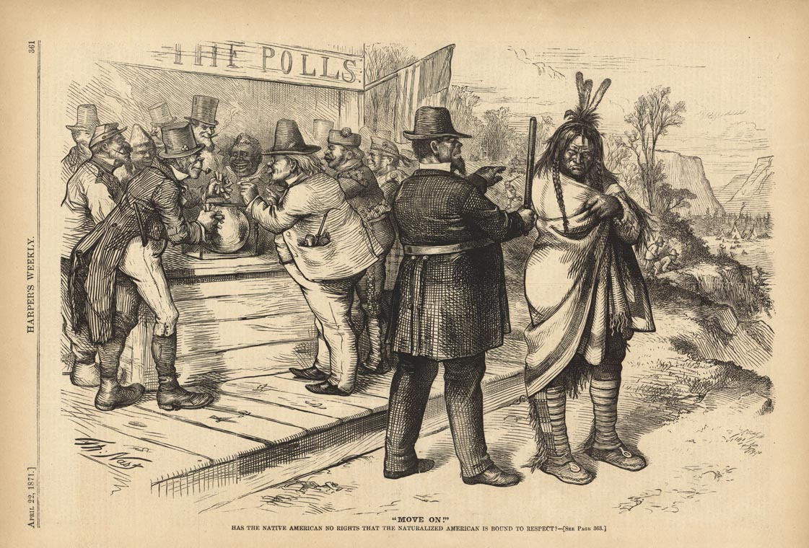

Slide 12
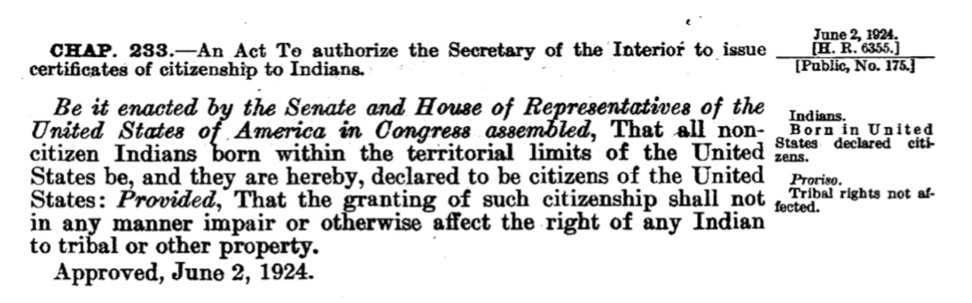
Document B: This excerpt is from The Statues at Large of the United States, which contains resolutions, treaties, conventions, and executive proclamations. It is published by Congress under the direction of the Secretary of State.

Slide 13
Document C: “The Life of Henry Mitchell” (interview 1938-1939)
One of the Indians went over to Old Town once to see some official in the city hall about voting. I don’t know just what position that official had over there, but he said to the Indian, ‘We don’t want you people over here. You have your own elections over on the island, and if you want to vote, go over there.’
Just why the Indians shouldn’t vote is something I can’t understand.

