Slide 1

Cold war assignments
Mrs. Love Spring 2020

Slide 2
How to submit your assignments
All assignments can be emailed to me
You can also take pictures of your assignments and send them to me via email or remind
Or you can hold on to your assignments until we return to school ☺

Slide 3
Additional Resources for the cold war
Check out this Crash Course Video if you would like more information about the Cold War
https://www.history.com/topics/cold-war/cold-war-history
I’ve posted a textbook chapter on my website for you to look over to get more information

Slide 4
Assignment #1 America the Story of us
Watch the ”SuperPower” episode.
As you watch the episode answer the questions on page 2 of the assignment document

Slide 5
Assignment #2: Cold War overview
Read the Cold War Overview Reading. (page 3 of the assignment document)
Complete 1-pager notes.
  An example is on the next slide
Each box corresponds to a specific section of the reading
You can use the template provided or create your own as long as it meets the requirements →
  A printable template is the the assignment document
Feel free to add more images than what’s required! Get creative!
Directions for 1-pager notes
(1) Border- causes of the Cold War
Box 2- US Characteristics
Box 3— USSR Characteristics
Box 4- What was the Cold War?
Box 5- What was the Iron Curtain? (include image)
Box 6- What was NATO? (include image)
Box 7- What was Containment? (include image)
Box 8- What was the Warsaw Pact? ((include image)

Slide 7
Assignment #3- Cold war timeline
Use the events provided on page 5 of the assignment document to create your timeline.
1
See example on the next slide.
The template to complete the timeline is on page 6 of the assignment document. You are welcome to do this by hand if you are unable to print the template.
2

Slide 8
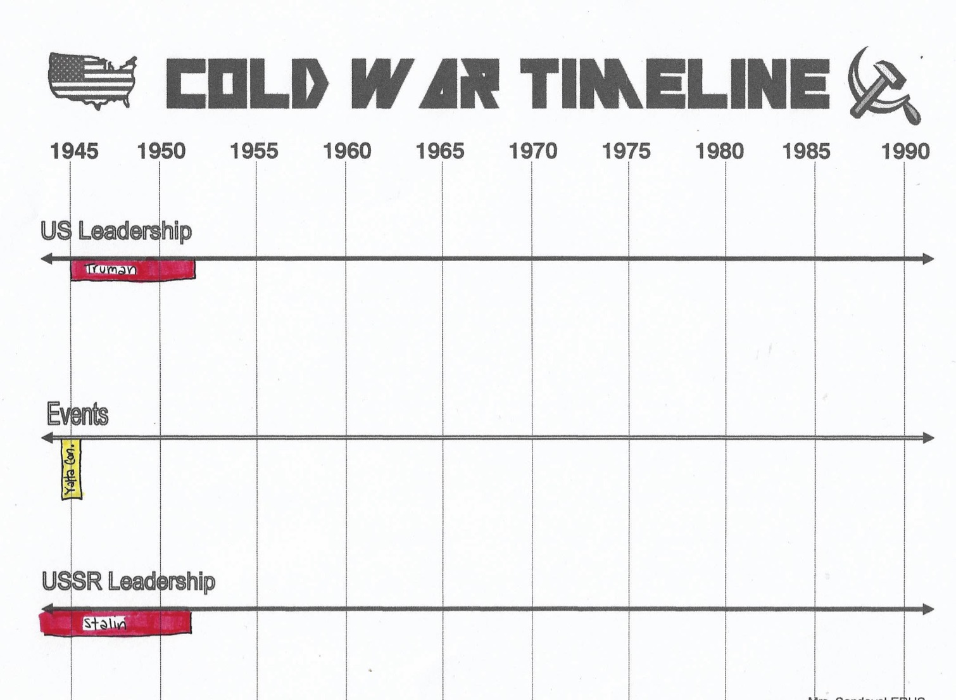

Slide 9
ASSIGNMENT #4 Document Based activity
Who was primarily responsible for the Cold War—the United States or the Soviet Union?

Slide 10
CHQ- Who was primarily responsible for the cold war-- the United States or the Soviet Union?
Directions:
Review the following slides to gather more background information on the Cold War
If you would like to hear a clip of the Iron Curtain speech, follow this link
  https://www.loc.gov/exhibits/churchill/wc-coldwar.html#252
  After following the link you may need to scroll down a little bit.
After you have reviewed the slides…
  Read each document provided and answer the guiding questions
  After you have gone through each document answer the Central Historical Question

Slide 11
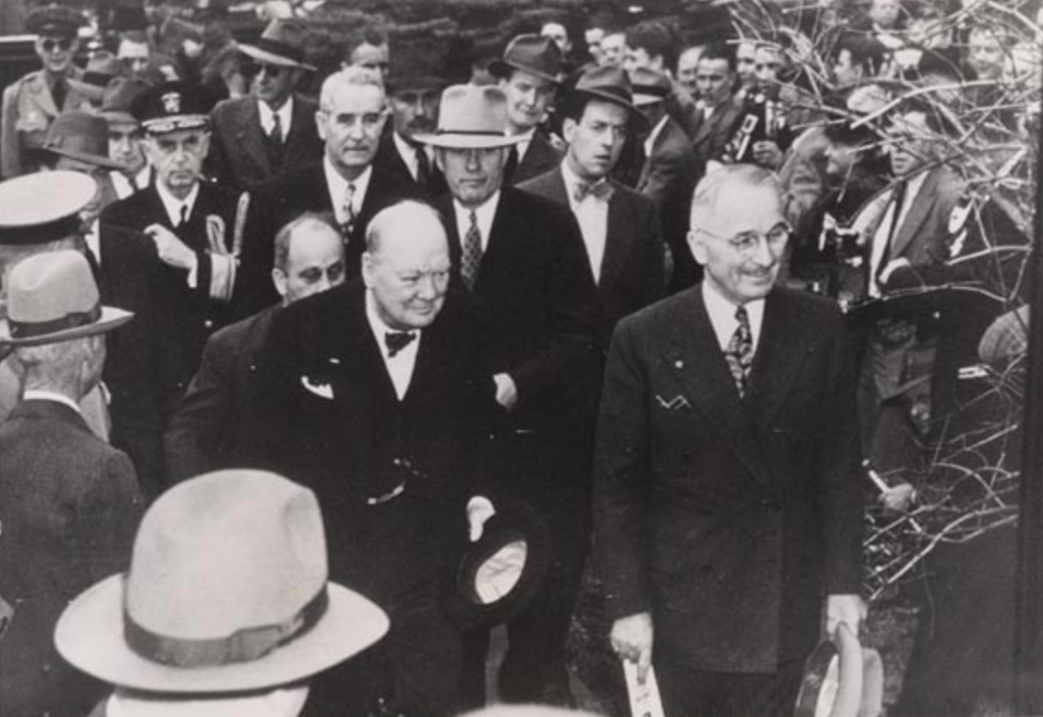
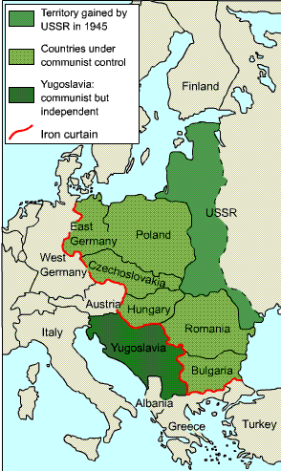
The iron curtain
Winston Churchill with President Truman just before the Iron Curtain Speech
Map of the “Iron Curtain”

Slide 12
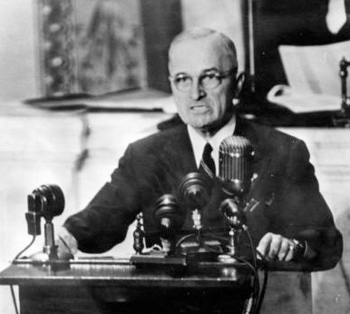
The Truman doctrine, 1947
President Truman outlined the Truman Doctrine to a joint session of Congress in March of 1947

Slide 13
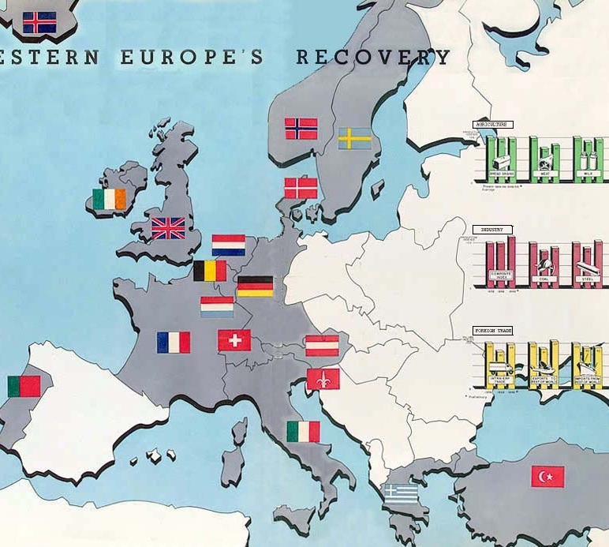
The Marshall plan, 1947
Nations that had received aid by 1950

Slide 14
Marshall plan, 1947
Stuttgart, Germany before and after Marshall Plan aid.

Slide 15
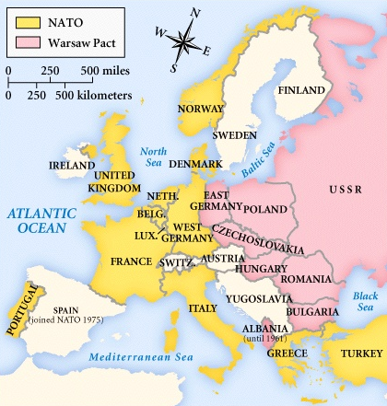
Nato treaty, 1949 warsaw pact, 1955

