Slide 1
The Homestead Strike
Why did the Homestead Strike turn violent?

Slide 2
Workers formed labor unions to protect their rights and to give them power to collectively bargain.
Business owners saw labor unions as unfair because they prevent competition.
Throughout the industrial era, unions were involved in a number of strikes; often, these strikes turned violent.

Slide 3
Andrew Carnegie (robber baron, captain of the steel industry) owned a steel mill in Homestead, PA, near Pittsburgh.
Union at the steel mill, the Amalgamated Association (AA), formed and won a couple of early strikes.
Homestead was run by Henry Clay Frick whose goal was to break the union.
When the union’s contract was up in 1892, Frick refused to negotiate a new contract and locked workers out.
Frick hired the Pinkerton Detectives to provide security and break the strike.
When the Pinkerton’s tried to enter the mill, there was conflict. The conflict lasted for 14 hours and left 16 people dead.
The strike lasted four more months until the union gave in. Frick succeeded in breaking the union.

Slide 4
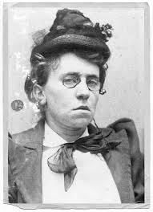
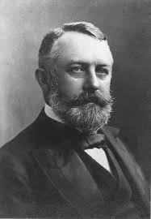
Two Perspectives
Emma Goldman
Henry Frick

Slide 5
Document A- Emma Goldman
Sourcing:
Who is the author?
What position do you expect her to take on the strike?
When was this written? How does that make you feel about the reliability of the document?
Close Reading
circle all the words that seem particularly strong and think about what effect these words have.
Do these words make one side seem “right” or “wrong”? How do you know?
Whose perspective is missing in this document?

Slide 6
Document B: Henry Frick
Sourcing:
Who wrote this? What’s his perspective?
How might his description and his language differ from Goldman’s?
Date July 8—one week after the crisis—how might this effect what Frick will say?
Close Reading:
What words stand out?
Is there any evidence that he’s trying to sound reasonable and logical? Why might he want to sound reasonable?

Slide 7
Why did the Homestead Strike turn violent?
What are the differences between Goldman’s account and Frick’s account?
Which account do you find more believable? Why?
Can we ever know what happened?
What other materials would you want to look at in order to try to figure out what happened at Homestead?

Slide 8
How are Goldman and Frick’s claims about the Homestead strike different?
Which claim is more believable? Why?

