Slide 1
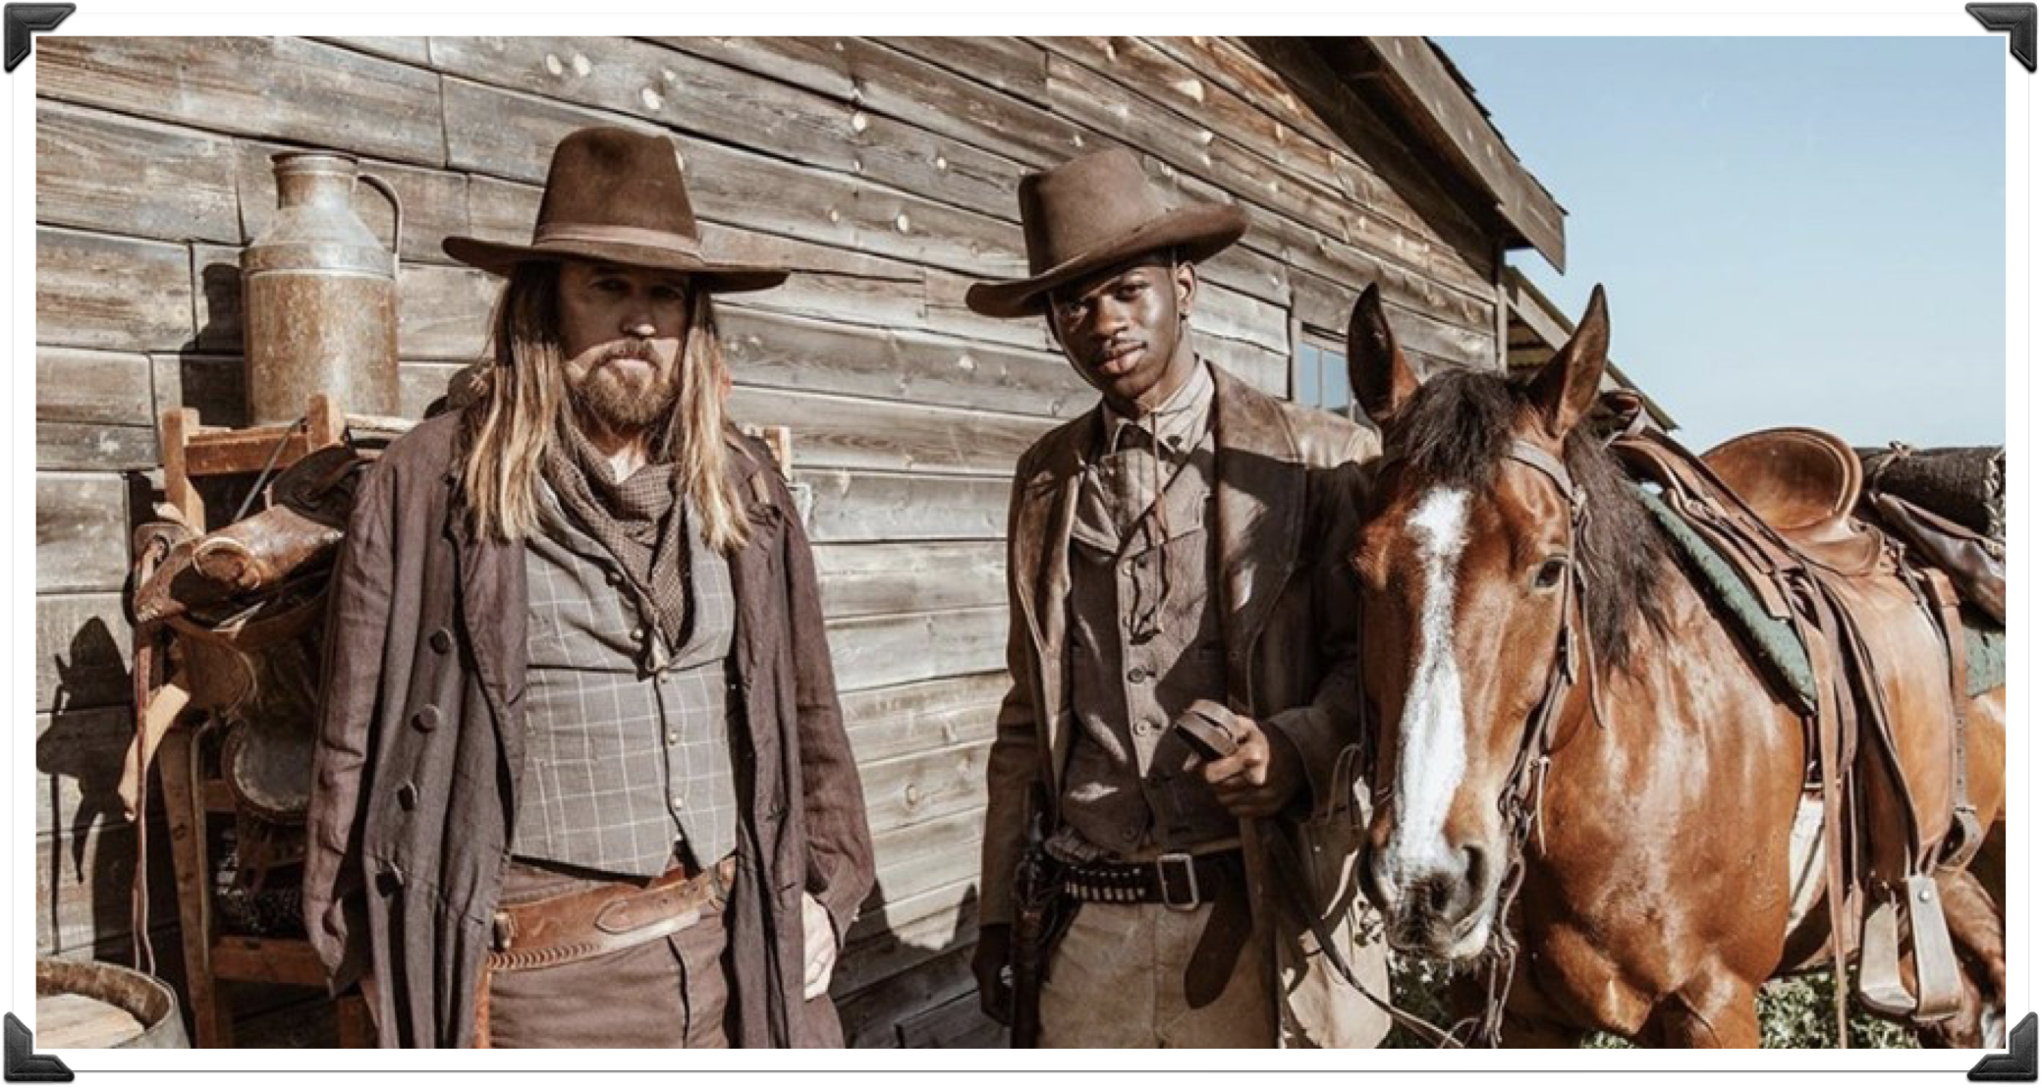
Transformation of the American West
Ch. 1 Section 2

Slide 2
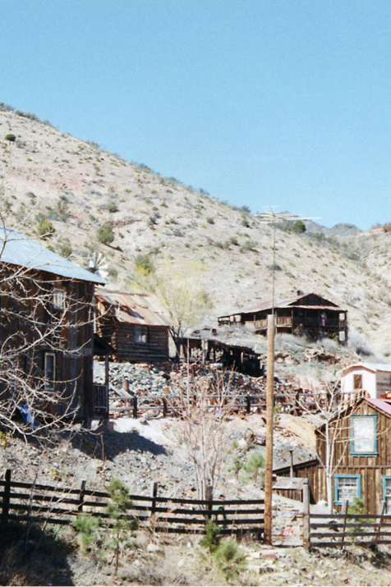
Growth of the Mining Industry
Growing industries in the East needed the West’s rich deposits of gold, silver, and copper.
This need brought many settlers to the western mountain regions.
Boomtowns appeared all over the Western region. Many would ultimately become “ghost towns” when the resources where depleted.

Slide 3
Vigilance Committees
Regions that grew as a result of mining:
  Colorado
  Dakota Territory
  Montana
    Denver becomes the second largest city in the West after San Francisco
Railroads through the Rocky Mountains

Slide 4
Think about it…
In your notes answer the following question:
How did the mining industry affect towns and cities in the West?
  Caused a cycle of boom & bust
  Rise in crime during boom times
  Growth of railroads
  Growth of cities

Slide 5
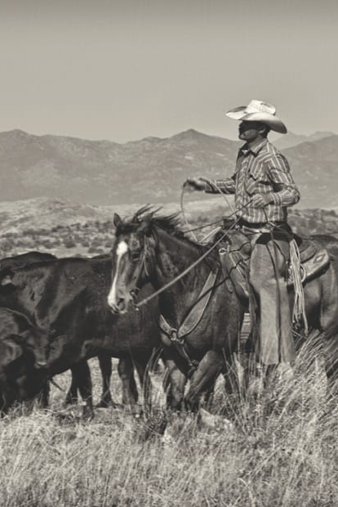
Ranching & Cattle Drives
Post Civil War, cattle ranches began to grow on the Great Plains
  The Texas Longhorn
Ranching grew as a result of the open range
The price of beef soars after the Civil War making long drives of cattle very profitable

Slide 6
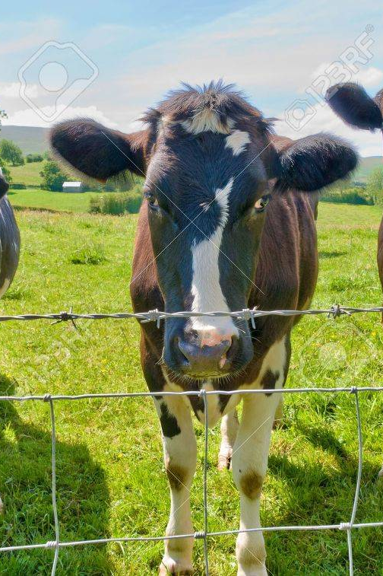
Demise of Cattle Drives
Barbed wire
Investors from the East & Britain put so much money into the cattle business that it causes an oversupply on the market
Harsh winters from 1886-1887

Slide 7
Think about it…
How did the invention and use of barbed wire affect the cattle industry?

Slide 8
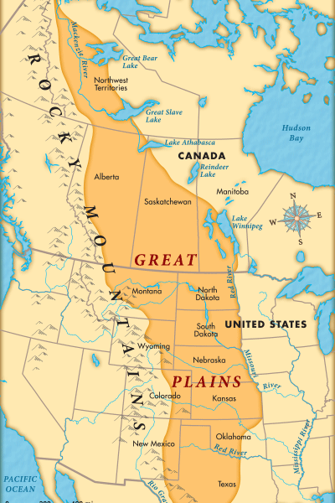
Life on the Plains

Slide 9
Railroads provide easy access to the Plains region
Homestead Act, 1862
Settlers were faced with a harsh environment
  Extreme heat & cold
  Fire
  Bugs!!!

